Slide 1
Lazy Code Motion
Bojian Zheng
CSCD70 Spring 2018
bojian@cs.toronto.edu

Slide 2
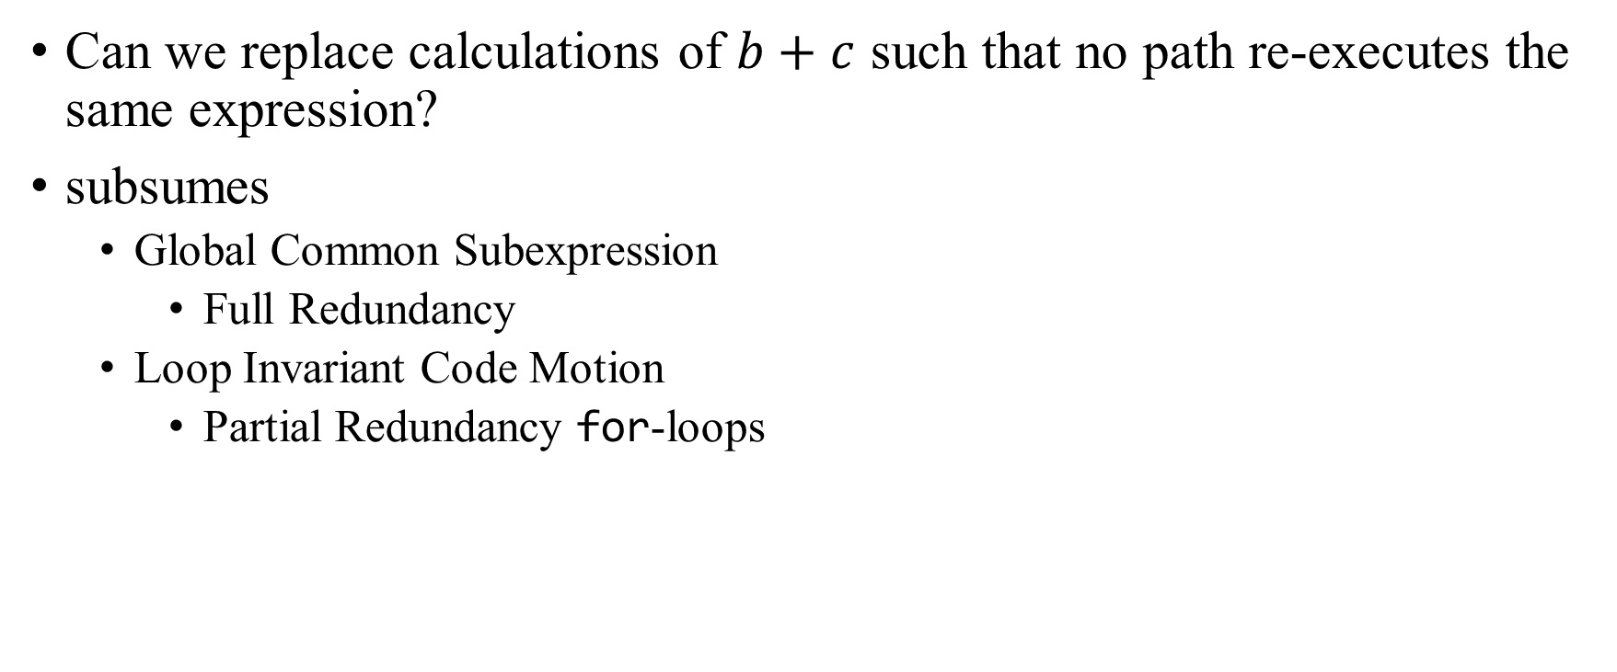
Partial Redundancy Elimination
Can we replace calculations of $b+c$ such that no path re-executes the same expression?
subsumes
  Global Common Subexpression
    Full Redundancy
  Loop Invariant Code Motion
    Partial Redundancy for-loops

Slide 3

Common Subexpression Elimination
On every path reaching $p$
  Expression $b+c$ has been computed.
  Neither $b$ nor $c$ is overwritten after the expression.

Slide 4

Loop Invariant Code Motion
Given an expression $b+c$ inside a loop,
  Does the value of $b+c$ change inside the loop?
  Is the code executed at least once?

Slide 5
Lazy Code Motion

Slide 6
Lazy Code Motion
The optimization of eliminating partial redundancy with the goal of delaying the computations as much as possible.
How are we going to achieve this?
  Anticipated Expressions & Will-be-Available Expressions
  Postponable Expressions
  Used Expressions

Slide 7
Our Goal
Safety
Maximum Redundancy Elimination
Shortest Register Lifetime

Slide 8
Anticipated Expressions

Slide 9
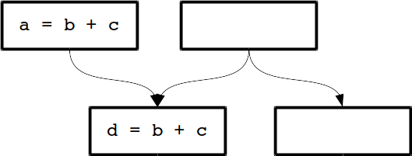

Safety
We cannot introduce operations that are not executed originally.
Given the diagram on the right, can we insert the expression $b+c$ on the right parent?

Slide 10
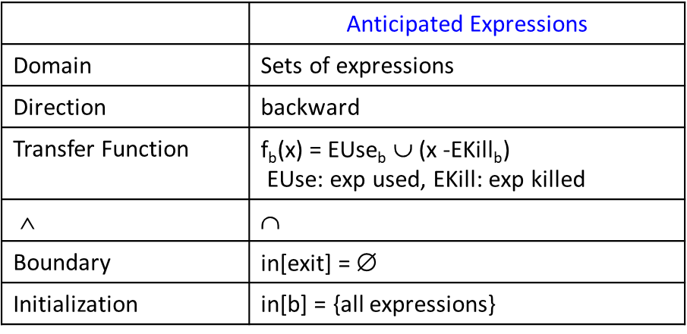
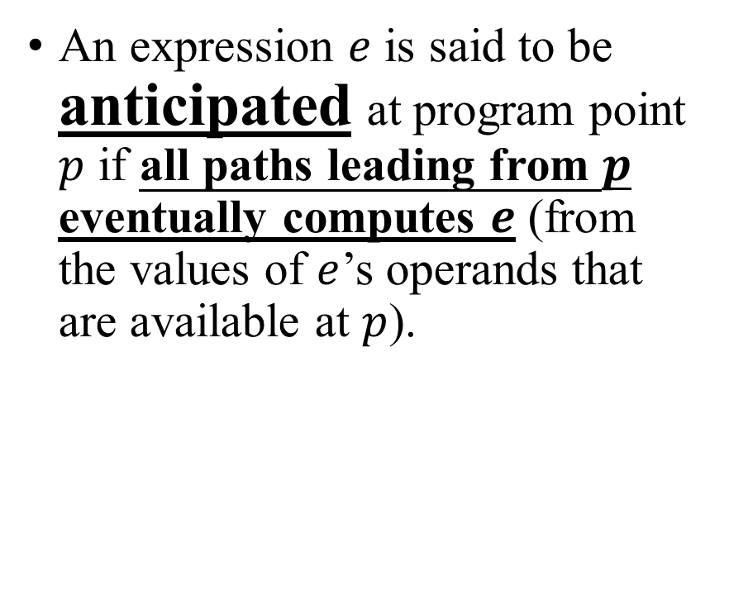
Anticipated Expressions
An expression $e$ is said to be anticipated at program point $p$ if all paths leading from $p$ eventually computes $e$ (from the values of $e$’s operands that are available at $p$).

Slide 11
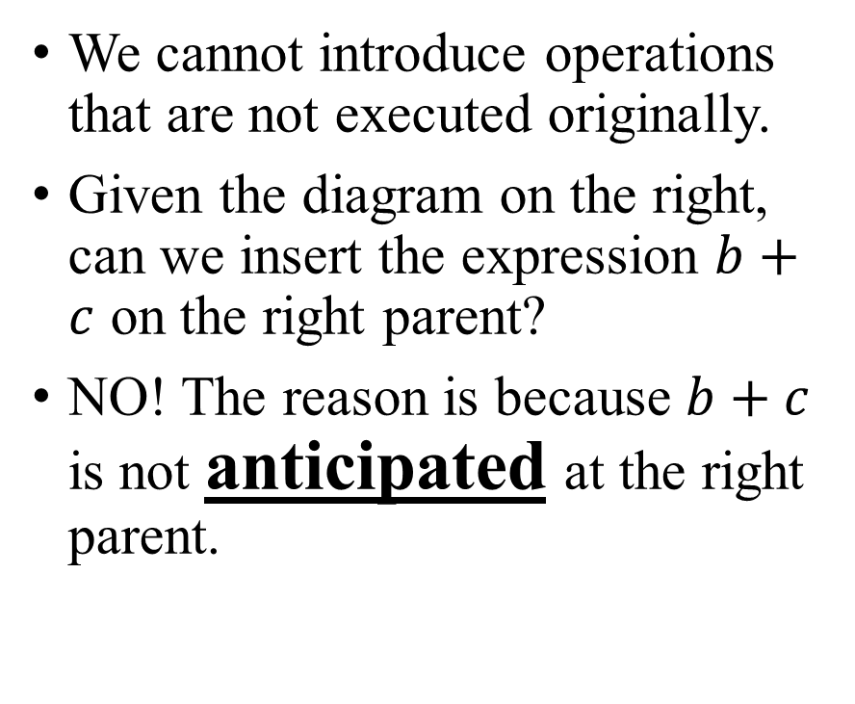
Safety
We cannot introduce operations that are not executed originally.
Given the diagram on the right, can we insert the expression $b+c$ on the right parent?
NO! The reason is because $b+c$ is not anticipated at the right parent.

Slide 12
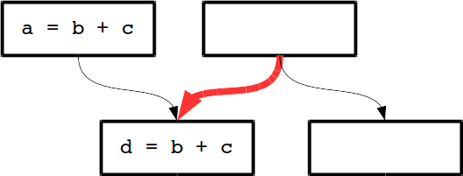
Critical Edge
If the source has multiple successors, and the destination has multiple predecessors, then the path that is connecting them is defined as Critical Edge.

Slide 13
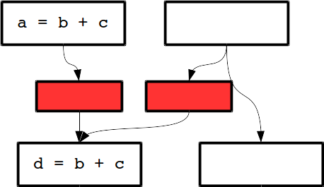
Solution: Synthetic Block
Add a basic block for every edge that leads to a basic block with multiple predecessors (not just the back edge).
This simplifies the algorithm – since we can always place at the beginning of the basic block.

Slide 14
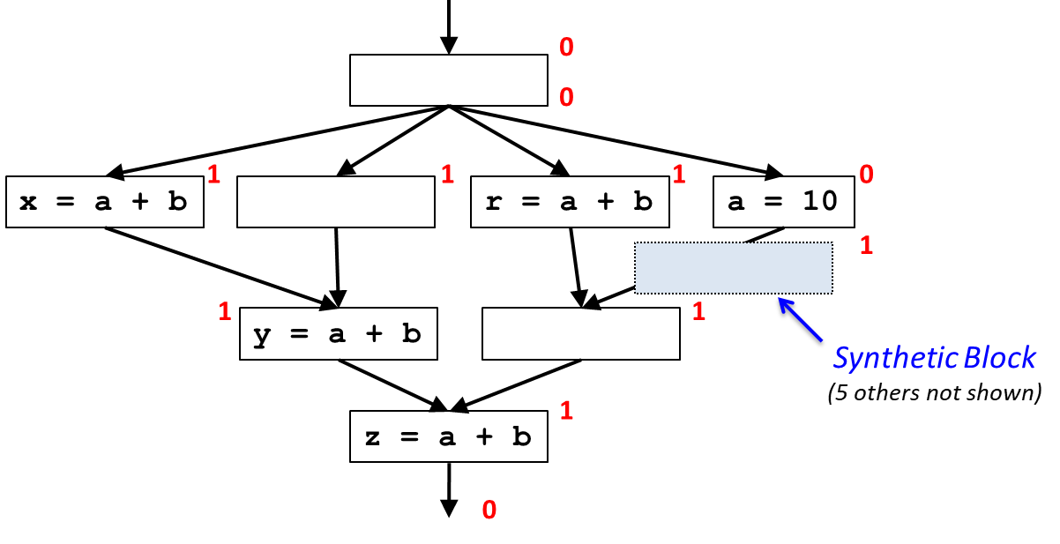
Example 1
What is the result after insertion at the anticipation frontier?

Slide 15
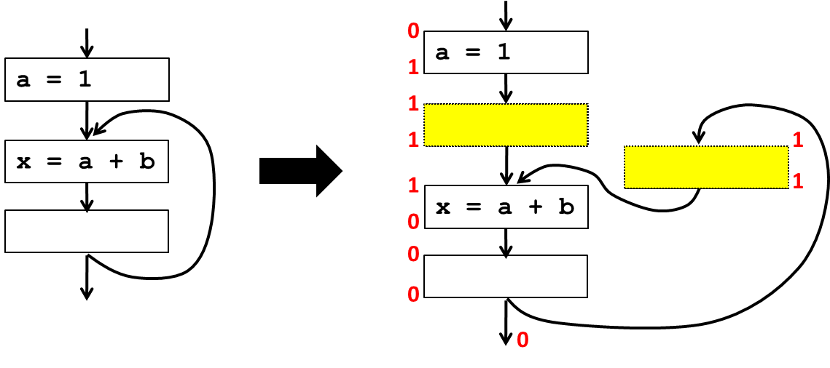
Example 2: Loop Invariance
Will insertion at the anticipation frontier help in this case?

Slide 16
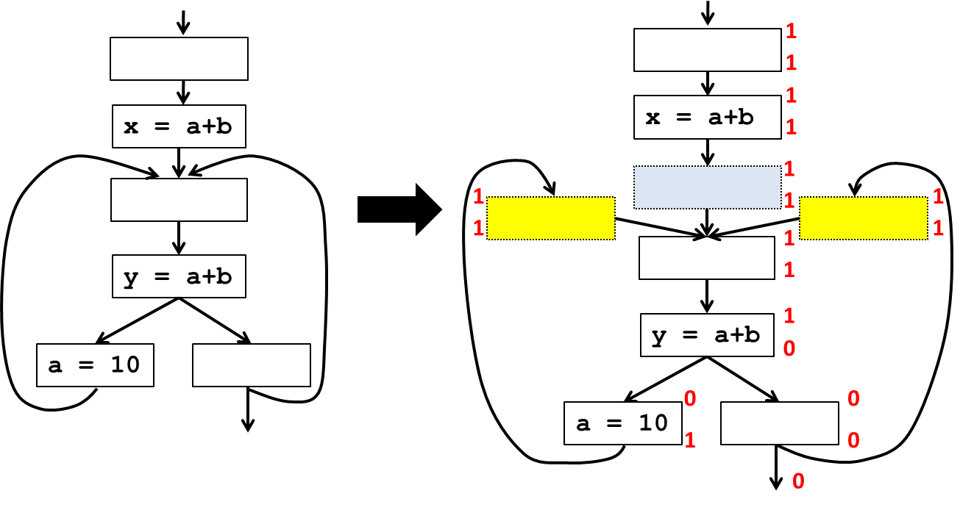
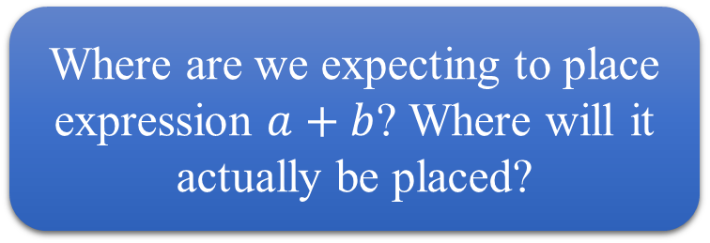
Example 3: More Complex Loop
Where are we expecting to place expression $a+b$? Where will it actually be placed?

Slide 17
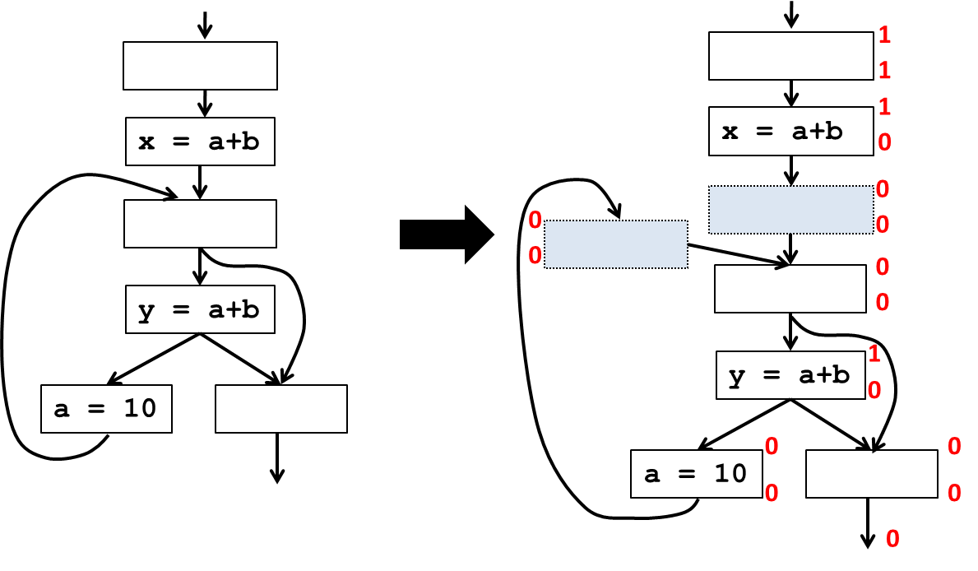
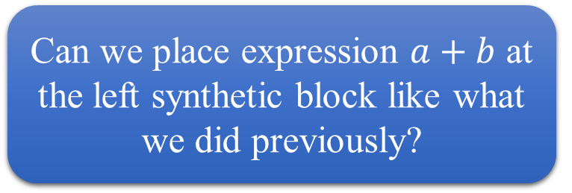
Example 4: Complex Loop Variation
Can we place expression $a+b$ at the left synthetic block like what we did previously?

Slide 18
Questions?
Keywords:
  Safety
  Anticipated Expressions
  Synthetic Block

Slide 19
Will-be-Available Expressions

Slide 20
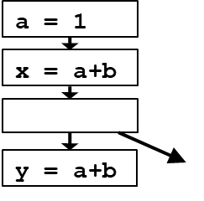
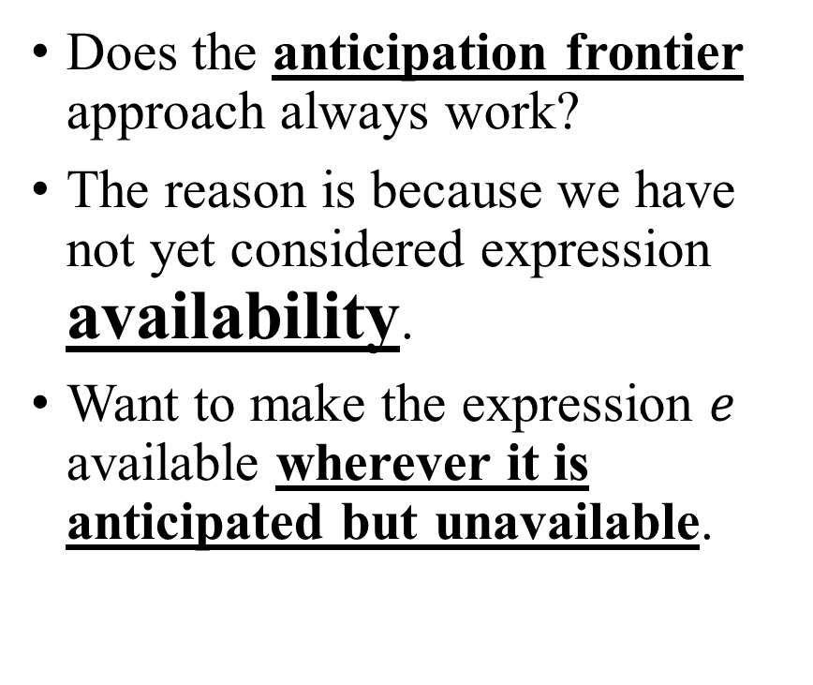
Complications
Does the anticipation frontier approach always work?
The reason is because we have not yet considered expression availability.
Want to make the expression $e$ available wherever it is anticipated but unavailable.

Slide 21
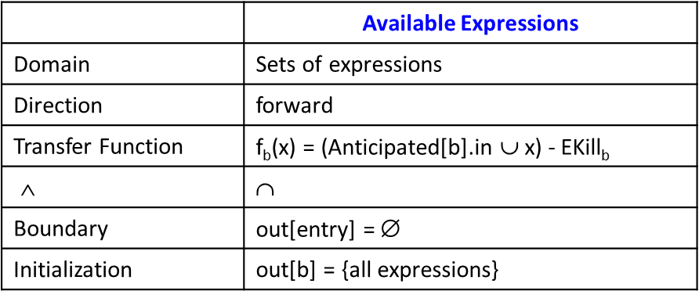
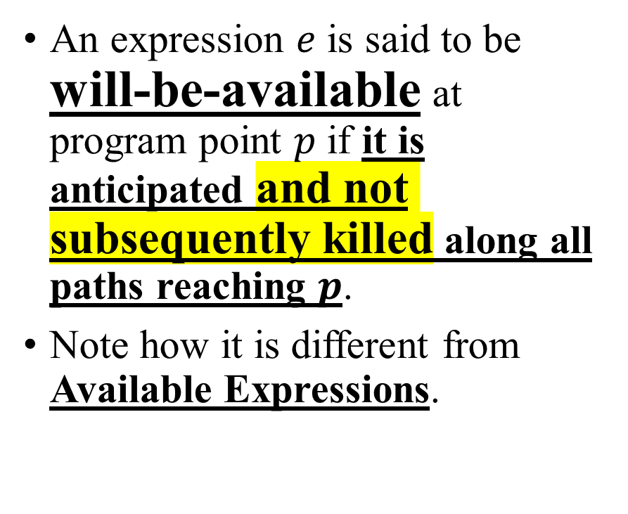
Will-be-Available Expressions
An expression $e$ is said to be will-be-available at program point $p$ if it is anticipated and not subsequently killed along all paths reaching $p$.
Note how it is different from Available Expressions.

Slide 22
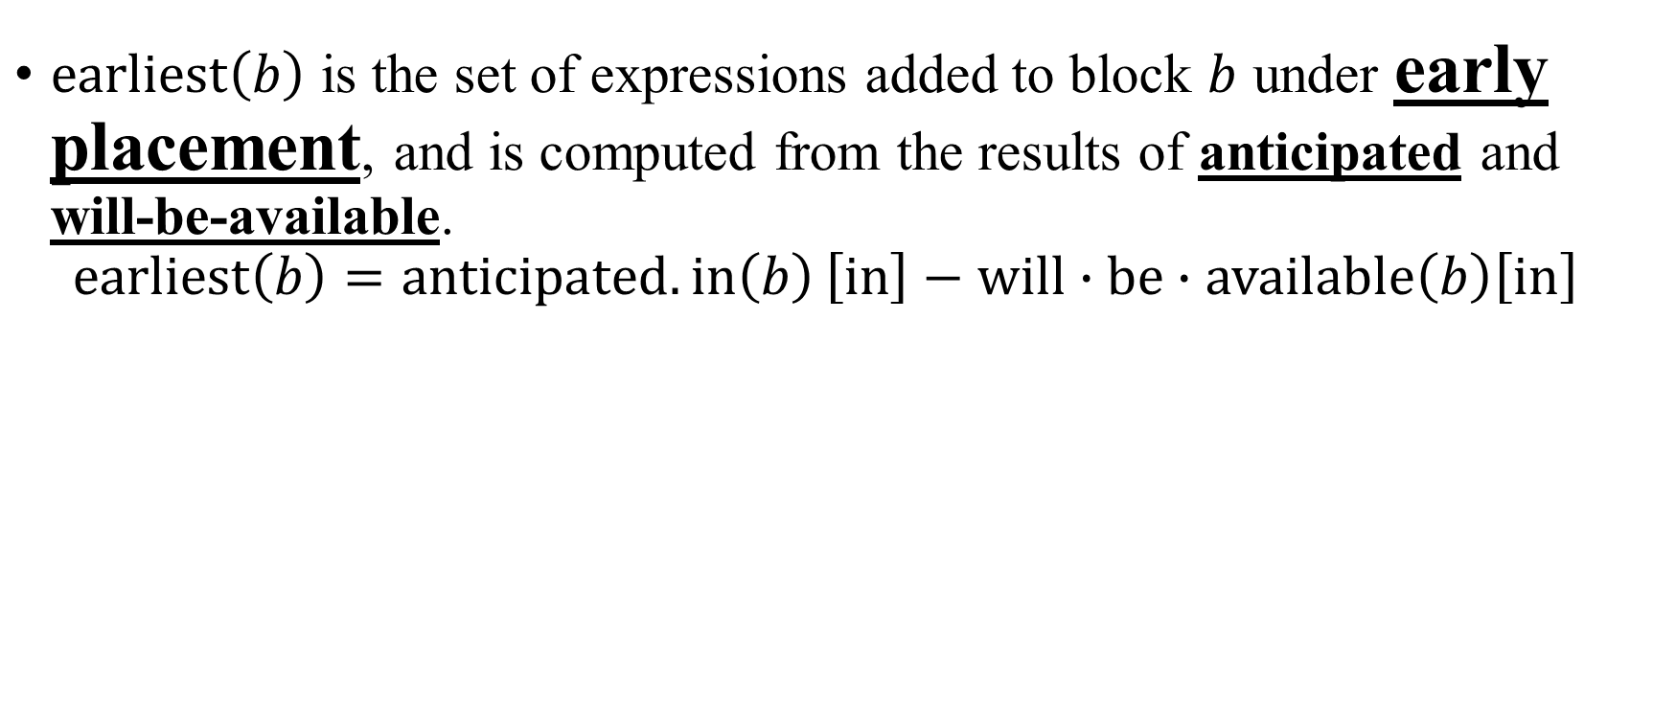
Early Placement
$\operatorname{earliest}\left(b\right)$ is the set of expressions added to block $b$ under early placement, and is computed from the results of anticipated and will-be-available.
$$\operatorname{earliest}\left(b\right)=anticipated.in\left(b\right)\left[in\right]−will∙be∙available\left(b\right)\left[in\right]$$

Slide 23
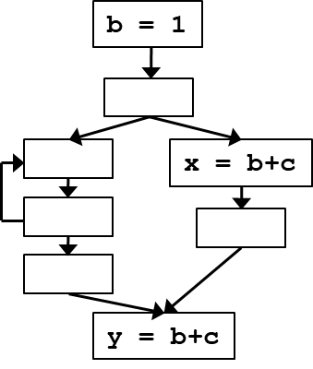
Example
Where is the earliest placement?
Is it different from the anticipation frontier?

Slide 24
Questions?
Keywords:
  Will-be-Available Expressions
  Early Placement

Slide 25
Postponable Expressions

Slide 26
Shortest Register Lifetime?
Early Placement goes against our goal of shortest register lifetime.
We want to delay creating redundancy to reduce register pressure.

Slide 27
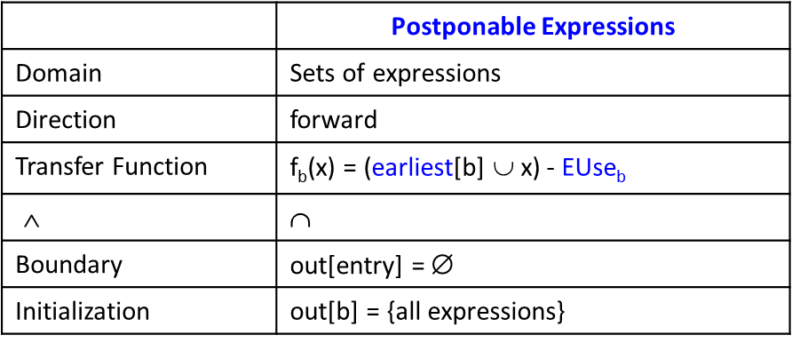

Postponable Expressions
An expression $e$ is said to be postponable at program point $p$ if all paths leading to $p$ have seen earliest placement of $e$ but not a subsequent use.

Slide 28
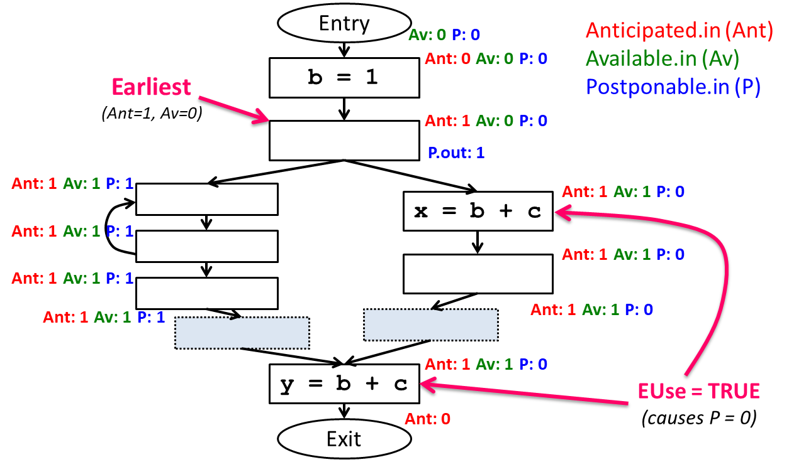
Example

Slide 29
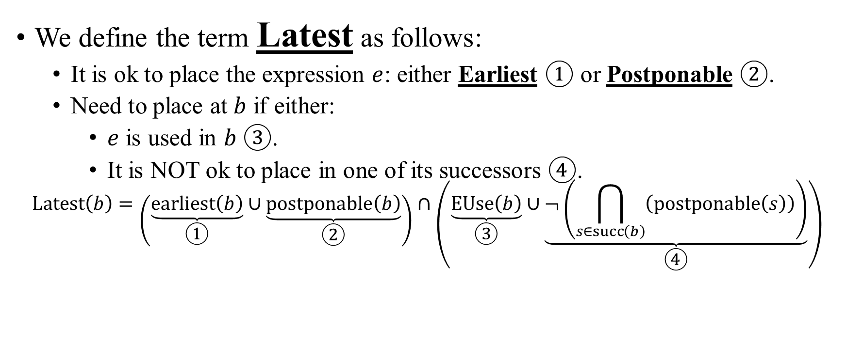
Latest Placement
We define the term Latest as follows:
  It is ok to place the expression $e$: either Earliest $①$ or Postponable $②$.
  Need to place at $b$ if either:
    $e$ is used in $b$ $③$.
    It is NOT ok to place in one of its successors $④$.
$$\operatorname{Latest}\left(b\right)=\left(\underset{①}{\underbrace{\operatorname{earliest}\left(b\right)}}∪\underset{②}{\underbrace{\operatorname{postponable}\left(b\right)}}\right)∩\left(\underset{③}{\underbrace{\operatorname{EUse}\left(b\right)}}∪\underset{④}{\underbrace{¬\left(\bigcap_{s∈\operatorname{succ}\left(b\right)}{\left(\operatorname{postponable}\left(s\right)\right)}\right)}}\right)$$

Slide 30
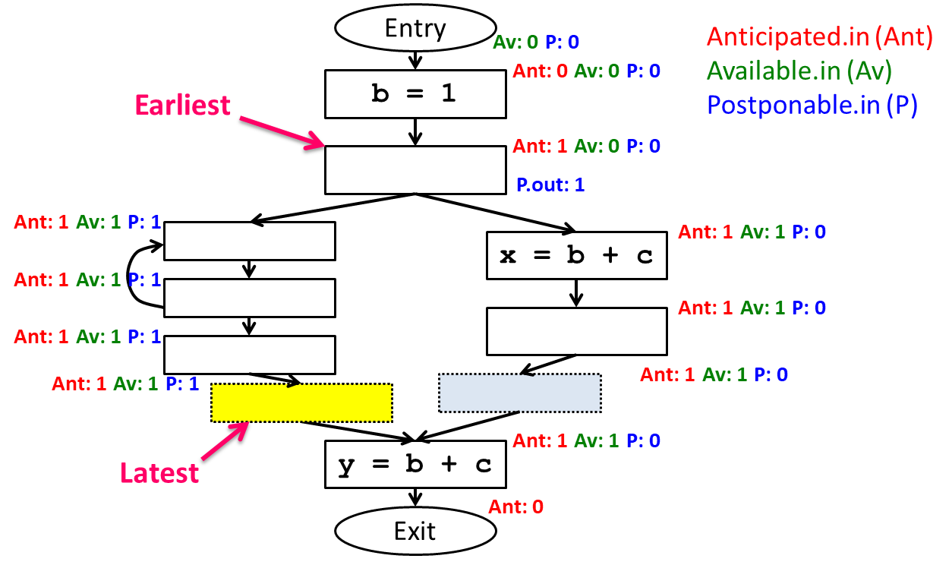
Example

Slide 31
Questions?
Keywords:
  Postponable Expressions
  Latest Placement

Slide 32
Used Expressions

Slide 33
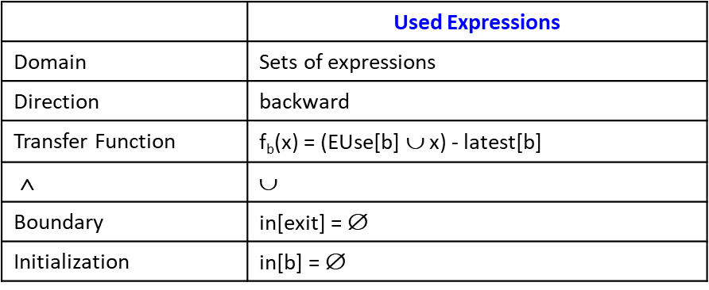
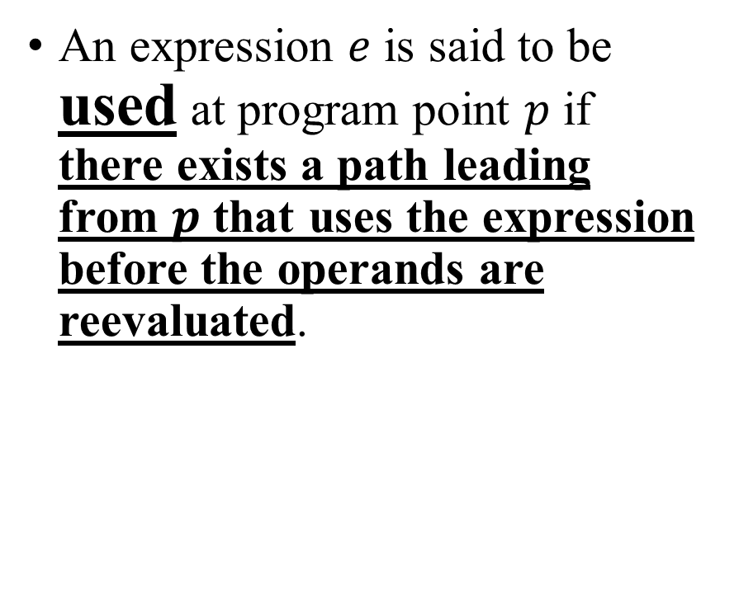
Used Expressions
An expression $e$ is said to be used at program point $p$ if there exists a path leading from $p$ that uses the expression before the operands are reevaluated.

Slide 34

Final Placement
Our code transformation goes as follows:
  $∀b$, if expression $e∈\left(\operatorname{latest}\left(b\right)∩\left(\operatorname{used}\left(b\right)\right)\right)$
  at the beginning of $b$, insert $t=e$, and replace every original $e$ with $t$

Slide 35
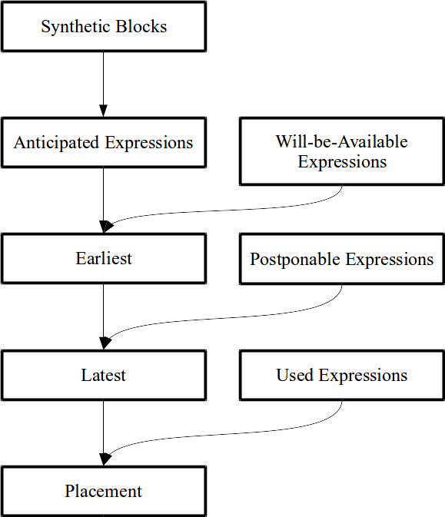
Summary

